Slide 1


QA Basics: Exam Preparation
SoftUni Team
Technical Trainers
Software University
http://softuni.bg

Slide 2
Table of Contents
Sample Exam Questions
QA Engineer Profession Explained
What Does a QA Engineer Do?
Job Description
Roles and Duties
The QA Curriculum @ SoftUni
Q&A Session

Slide 3
You Have Questions?
sli.do #QA-Basics

Slide 4

Sample Exam Questions

Slide 5
Question 1
A test scenario contains multiple:
Test drivers
Test cycles
Test cases
Test controls
Hint: Quality Assurance Intro lecture

Slide 6
Question 2
The following statement can be applied to which test level: "Testing must confirm that components collaborate correctly"?
Integration testing
Acceptance testing
Non-functional testing
Functional testing
Hint: Components collaborate

Slide 7
Question 3
Software testing is NOT a way:
To evaluate the features of the software item
To find all the bugs
To verify specified requirements
To reduce the risk of software failure
Hint: Seven testing principles

Slide 8
Question 4
Software testing process includes:
Test design
Test planning
Test reporting
Test execution
Choose the correct order, that these are performed.
2, 3, 1, 4
2, 1, 4, 3
1, 3, 4, 2
2, 3, 4, 1
Hint: Quality Assurance Intro lecture

Slide 9
Question 5
Which of the following list contains only non-functional tests:
Security testing, reliability testing, performance testing
Testing various configurations, beta testing, unit testing
Stress testing, component testing, portability testing
System testing, performance testing, alpha testing
Hint: Test Levels and Test Types lecture

Slide 10
Question 6
One of the fields on a form contains a text box which accepts numeric values in the range of 18 to 25. Which test will be negative?
19
21
25
17
Hint: Unit testing

Slide 11
Question 7
Which of the following requirements is testable:
The safety-critical parts of the system shall contain 0 faults
The system shall be built to be very fast
The system shall be user friendly
The response time shall be less than one second for the specified load
Hint: What could cause defects?

Slide 12
Question 8
Software testing activities should start:
When the requirements have been officially signed
As soon as the code is written
Before the debugging stage
As soon as possible in the development life cycle
Hint: Software Testing Process

Slide 13
Question 9
A bug tracking system:
is of limited value
should be used only by the test team
is a valuable source of project information during testing
only records defects
Hint: Bugs and Bug Tracking lecture

Slide 14
Question 10
Why should expected results be defined before execution?
To reduce the possibility of incorrect results
To assist in automation
To improve system efficiency
To improve design of the software
Hint: Bugs and Bug Tracking lecture

Slide 15

QA Engineer Profession Explained

Slide 16
What Does a QA Engineer Do?
A QA engineer monitors every phase of the software development process, including:
design
development
testing
debugging
delivery
Maintains the quality standards of the software at every stage and ensure the final product meets the requirements.
Defines the tests to verify that the software does not have any technical shortcomings

Slide 17
QA Tasks
Here is a list of typical tasks of a QA specialist:
Checking if the product complies with the requirements
Assessing risks
Planning ideas to improve product quality
Designing tests
Executing manual and automation tests
Analyzing the test results

Slide 18
QA Roles
There are four main QA roles:
Test Analyst - engaged in static testing of requirements and checks them for completeness and consistency
Test Designer - creates a set of tests based on requirements and plans configurations that are necessary for testing
Test Executor performs pre-planned tests, describes and documents the found errors, and steps for reproducing (or fixing) them
Test Manager - plans and monitors work related to testing such as deadlines, schedule, controlling requirements to tests, setting tasks, communicating with stakeholders

Slide 19
A workday of a QA Engineer
A typical workday of a QA specialist consists of several duties. Here are some of them:
Writing test cases, running tests, documenting errors (depending on the phase of the project)
Checking the bug tracking system for the fixed errors
Conducting meetups
Learning the requirements and their clarification with the customer
Communicating with developers
Writing test documentation

Slide 20
Skills and personal qualities
QAs should:
Have a broad IT knowledge and be eager to learn new things
Be able to communicate (the quality of communication in the development team directly affects the quality of the software)
Be attentive to details, be diligent, responsible, and persistent
Possess analytical skills, be able to model and work with abstractions
Have a critical mindset aimed to find errors

Slide 21
The career prospects of QA specialists
The main areas for professional development in the QA career:
Explore new areas and grow as a QA: junior QA -> middle QA -> senior QA -> QA team lead -> QA-manager -> Head of QA department.
If you are interested in automation and want to know what a QA automation engineer does, there’s an option to master automated testing and move along this direction. It requires deeper technical knowledge.
Upgrade your qualification to a Business Analyst or a developer.
Having gained enough experience, you can grow into a Project Manager, then into a Senior Project Manager

Slide 22

The QA Curriculum and Opportunities
Become a QA Automation Engineer and Start a Job

Slide 23
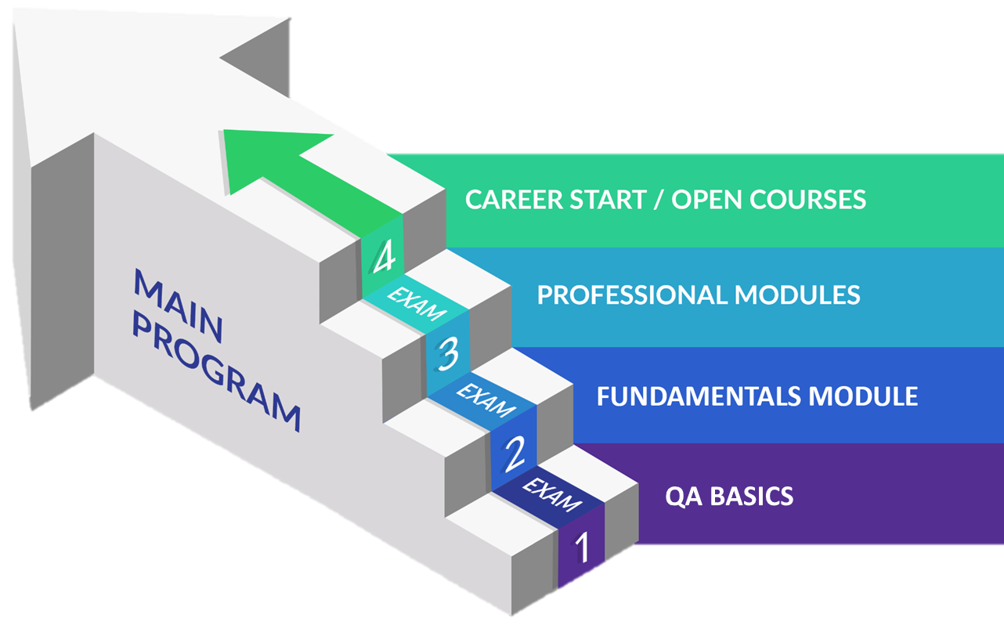
QA Engineering: Educational Program

Slide 24
Curriculum
Entry Module
QA Basics
1 month
Fundamentals Module
QA Fundamentals
Software Technologies Fundamentals
QA Fundamentals and Manual Testing
4 months
Professional Modules
Programming for QA
Back-End Test Automation
Front-End Test Automation
12 months
https://softuni.bg/qa/curriculum

Slide 25

Q & A Session

Slide 26

Summary
…
…
…
Exam preparation: Solving sample questions
QA profession: What does a QA engineer do?
QA curriculum: Your QA path
Q & A Session: Your questions answered

Slide 27
Questions?
Notes:
27

Slide 28














SoftUni Diamond Partners

Slide 29

Educational Partners

Slide 30

License
This course (slides, examples, demos, exercises, homework, documents, videos and other assets) is copyrighted content
Unauthorized copy, reproduction or use is illegal
© SoftUni – https://about.softuni.bg/
© Software University – https://softuni.bg
Notes:
30

Slide 31
Trainings @ Software University (SoftUni)
Software University – High-Quality Education, Profession and Job for Software Developers
softuni.bg, about.softuni.bg
Software University Foundation
softuni.foundation
Software University @ Facebook
facebook.com/SoftwareUniversity
Software University Forums
forum.softuni.bg
Notes:
31

